Slide 1
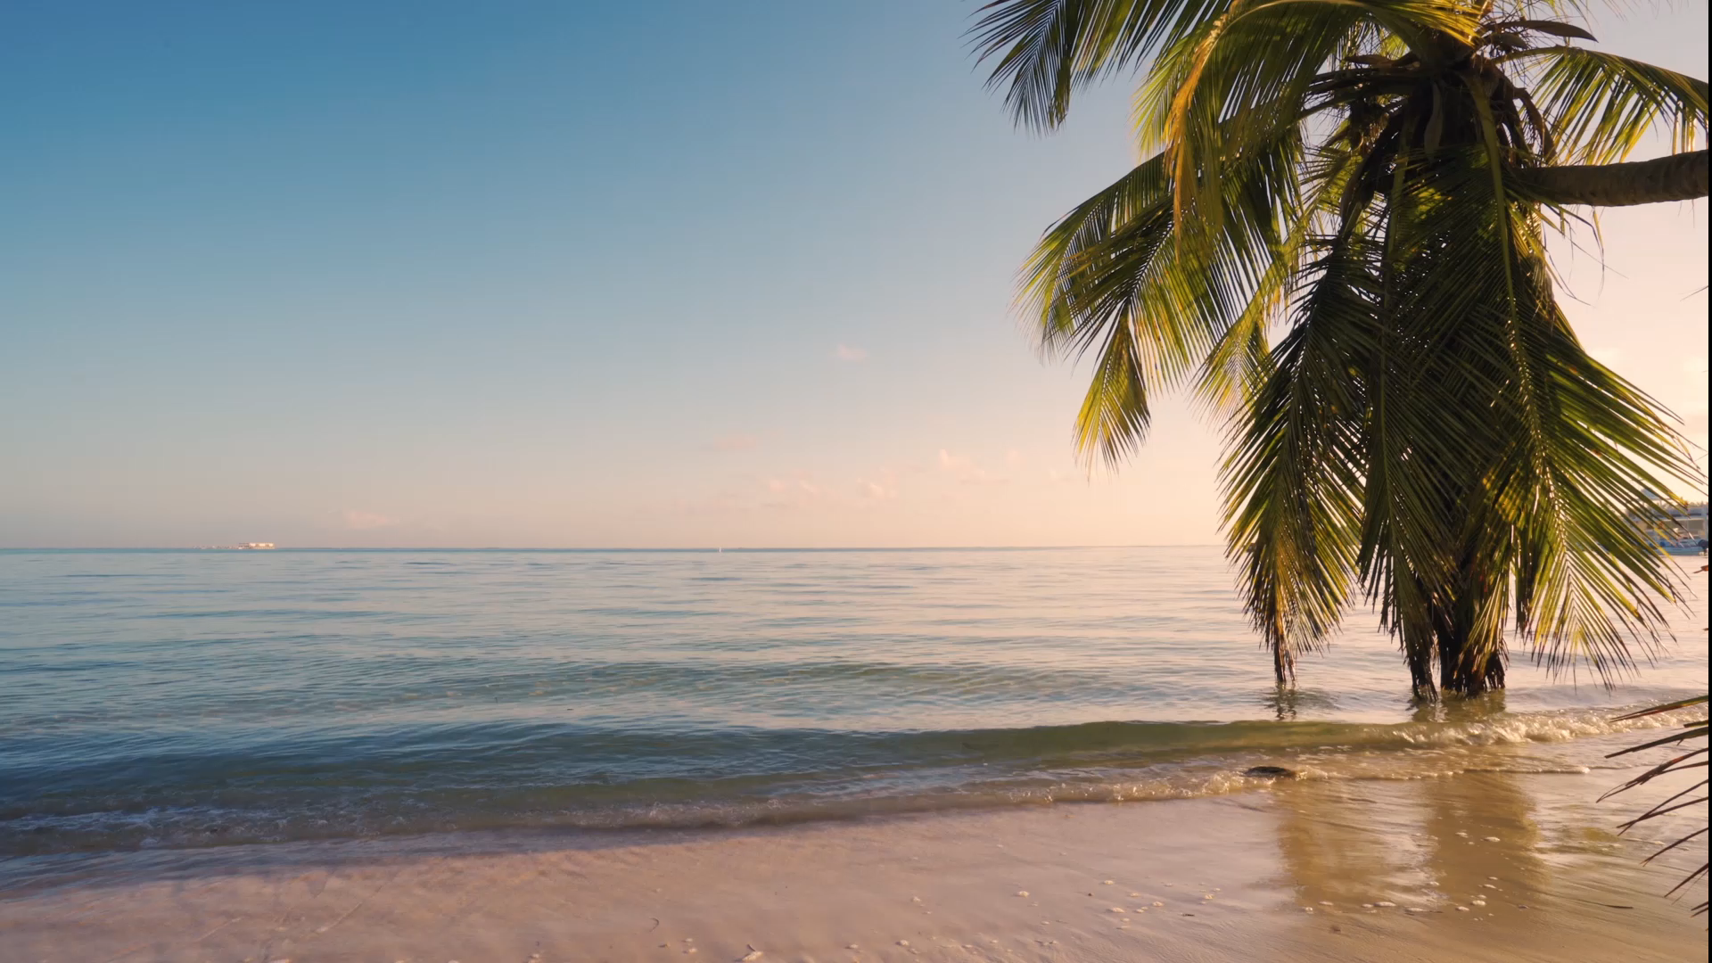
Love, & Much More Honeymoon Destinations
Tiffany McCord
Brandy Lee
Briana Moyer

Slide 2
Overview
Our group project is a honeymoon destination package order form that allows the user to select one destination from three options on the welcome page. Once the user selects a destination, the user will then select travel dates. Upon confirming the dates, the user will select either a basic, premium or all-inclusive package. The package screen will outline what is included in each package such as hotel amenities, spa packages, beverage packages, meal plans etc. User will be able to click the "calculate" button to see their total based on their selections. User will be able to clear their selections and go back to the first screen to compare prices and package options. A “Click to book” button will allow users to lock in their honeymoon destination package and take user to the final form. This last screen will display once the user selects the Click to book link and will serve as the confirmation that the selected destination has been reserved and thank the user for choosing our business.
We chose this theme because Tiffany McCord is getting married in April and just went through the honeymoon ordering process and who doesn’t love to plan trips to exotic places! This Windows application will allow users to select the best honeymoon packages at select destinations. It will offer rates for different room packages.

Slide 3
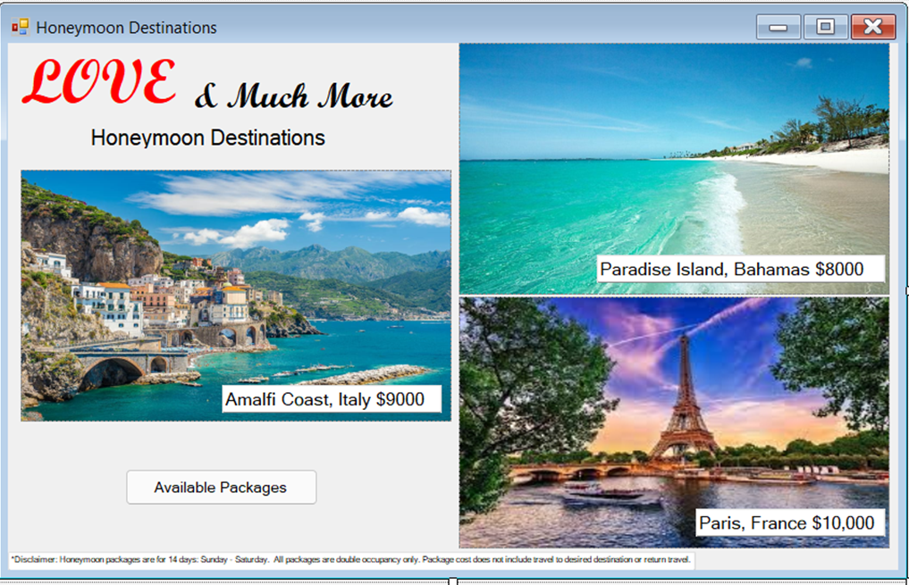

Slide 4
Available Packages
Basic Package – $2,000
Meal Plan (Breakfast for 2 guests for 7 days and 1 honeymoon dinner for 2)
Stocked bar in room (Beer and wine only)
Spa Package (90-minute couples massage therapy for 2 guests)
Excursions (1 mini excursion determined by destination and availability)
All tips, taxes and gratuities are included in all packages along with hotel amenities and chauffeur between airport and resort on arrival and departure

Slide 5
Available Packages
Premium Package – $3,000
Meal Plan (Unlimited snacks and Breakfast, lunch, and dinner for 2 guests for 7 days)
Beverage Package (Stocked bar in room and unlimited spirits and wines)
Spa Package (90-minute couples massage therapy, manicure, and pedicure for 2 guests)
Excursions (2 mini excursions determined by destination and availability)
All tips, taxes and gratuities are included in all packages along with hotel amenities and chauffeur between airport and resort on arrival and departure

Slide 6
Available Packages
All Inclusive Package – $4,000
Meal Plan (All meals, honeymoon dinner and unlimited snacks included)
Beverage Package (Stocked bar in room and unlimited spirits and wines)
Spa package (1 each - 90-minute couples massage therapy, manicure, pedicure, facial, mud bath and waxing for 2 guests)
Excursions (3 mini excursions determined by destination and availability)
All tips, taxes and gratuities are included in all packages along with hotel amenities and chauffeur between airport and resort on arrival and departure

Slide 7
Form One - Requirements
Form 1 displays business name Love, and Much More Honeymoon Destinations, travel requirements, packages, and destination images. Form 1 allows user to select the desired honeymoon destination from Paradise Island, Bahamas, Amalfi Coast, Italy or Paris, France by clicking on an image. Users will be able to see available packages by hovering over “Available Packages.”
Clicking on the location image will pass destination information to Form 2.
Honeymoon packages are for 14 days: Sunday - Saturday. All packages are double occupancy only. Package cost does not include travel to desired destination or return travel.

Slide 8
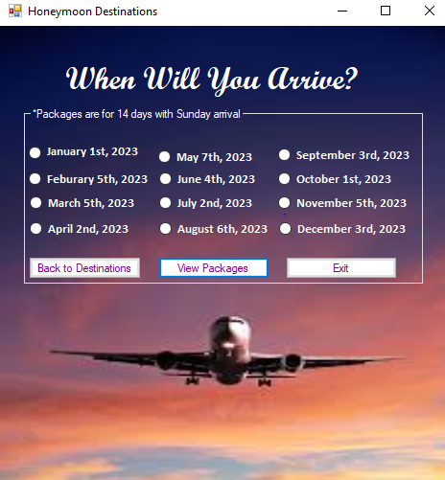
Form Two

Slide 9
Form Two - Requirements
Form 2 will display the selected destination and various travel dates to choose from. Packages are for 14 days from Sunday to Saturday.
The user will only be able to click one date option at a time.
The user will be able to go back and select a different destination by selecting the "Back to Destinations"
When user selects their date and clicks “Select Package" the information will be passed to Form 3.

Slide 10
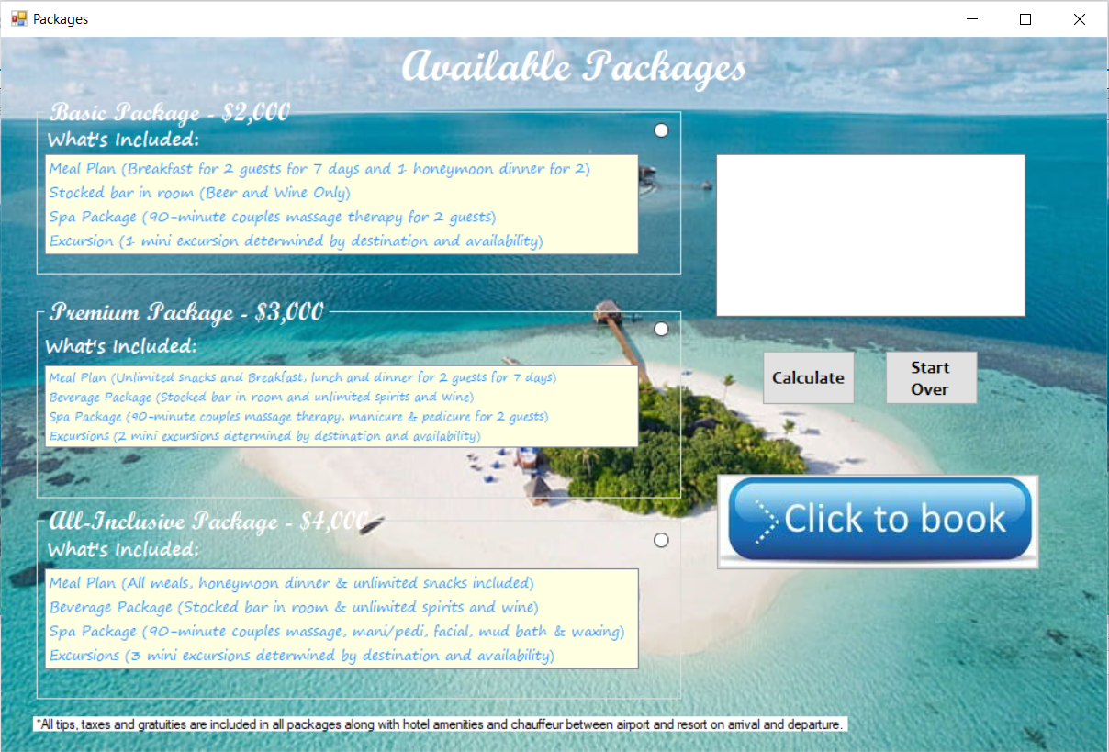
Form Three

Slide 11
Form Three - Requirements
Travel dates and destination will be carried over to form 3. Here the user will select one out of three available packages: Basic, Premium or All Inclusive. Form 3 will provide details on what is included in each package.
The user will be able to calculate costs by clicking the “Calculate” button.
An overview of the selections (destination, travel dates and package) along with the total cost will be displayed in a Textbox.
If satisfied with selections, the user will be able to click “Click To Book” to complete the reservation and pass the information to form 4.
If changes need to be made, the user will be able start over by selecting the “Start Over” button.

Slide 12
Form Four
Congratulations!!
You have reserved your -base, premium or all inclusive- honeymoon package (package dependent upon user selection) to Bahamas, France or Italy (location dependent upon user selection) with an arrival date of – date (date dependent on user selection).
Thank you for choosing Love, and Much More Honeymoon Destinations to assist you in planning your honeymoon.
Congratulations on the wedding and we look forward to seeing you!

Slide 13
Form Four - Requirements
Form 4 will display an overview of the selections and a message to confirm the selected destination has been reserved and to thank the user for selecting our business. The message to be displayed will be included in the code.

