Slide 1
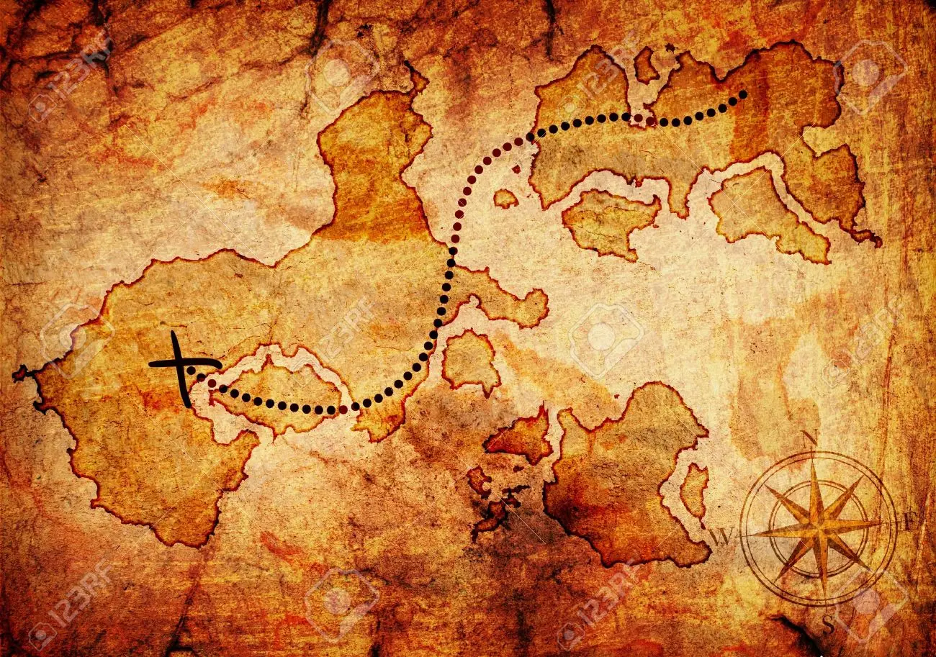


The Voyagers
Quest II PIM*
Slide Contributors: Captain: Brandy Lee
Crew: Cameron Leyva, Sophia Veilleux, and Elyssa Lewis
https://www.123rf.com/photo_12705144_old-treasure-map-isolated-on-a-white-background.html

Slide 2

Welcome aboard for Quest II of The Voyagers! Throughout this journey, we will summarize our planned intended movement (PIM) by reviewing the ship’s organization and regulation manual (SORM). Created to bring us safely to the port of destination, the SORM outlines our purpose statement, port of destination, vision-goals-success, waypoints, standing orders, values and behavior, Organization of Leadership, The Cut of One's Jib, Roles and Responsibilities, Battle Rhythm, Operating procedures, decision making, time management, sanctions and conflict resolution – essentially everything you need to know to prepare for this quest.
Slide Contributions: Brandy, Cameron, Sophia and Elyssa
https://mylittleenglishpage.wordpress.com/2017/11/18/idiom-in-l-learn-the-ropes/

Slide 3
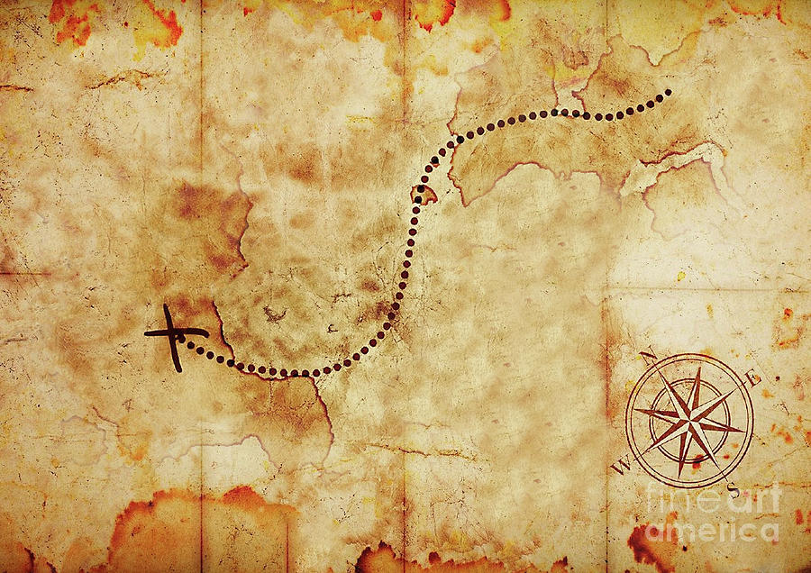
Scavenger Hunt
We also need your help in a scavenger hunt. We seem to have misplaced part of the manifest that outlines Tuckman's Stages of Group Development. We need this before getting underway to ensure we stay on course for this mission. SORM topics are categorized into the first three stages of development – Forming, Storming and/or Norming. Because the stages are concurrent and not linear, some topics are found in multiple stages. Please help us by finding the lone embedded "F" for Forming, "S" for Storming, and/or "N" for Norming for each SORM topic. If you find any of these bold-font capital letters, write it down with the SORM topic so we can outline Tuckman's Stages of Group Development and fill in the missing piece of the manifest. Will you join us on this journey through the SORM to help you learn the ropes and help us locate part of the missing manifest so we can get underway?
https://pixels.com/featured/old-treasure-map-mehrshad-chakameh.html
Slide Contributions: Brandy, Cameron, Sophia and Elyssa

Slide 4
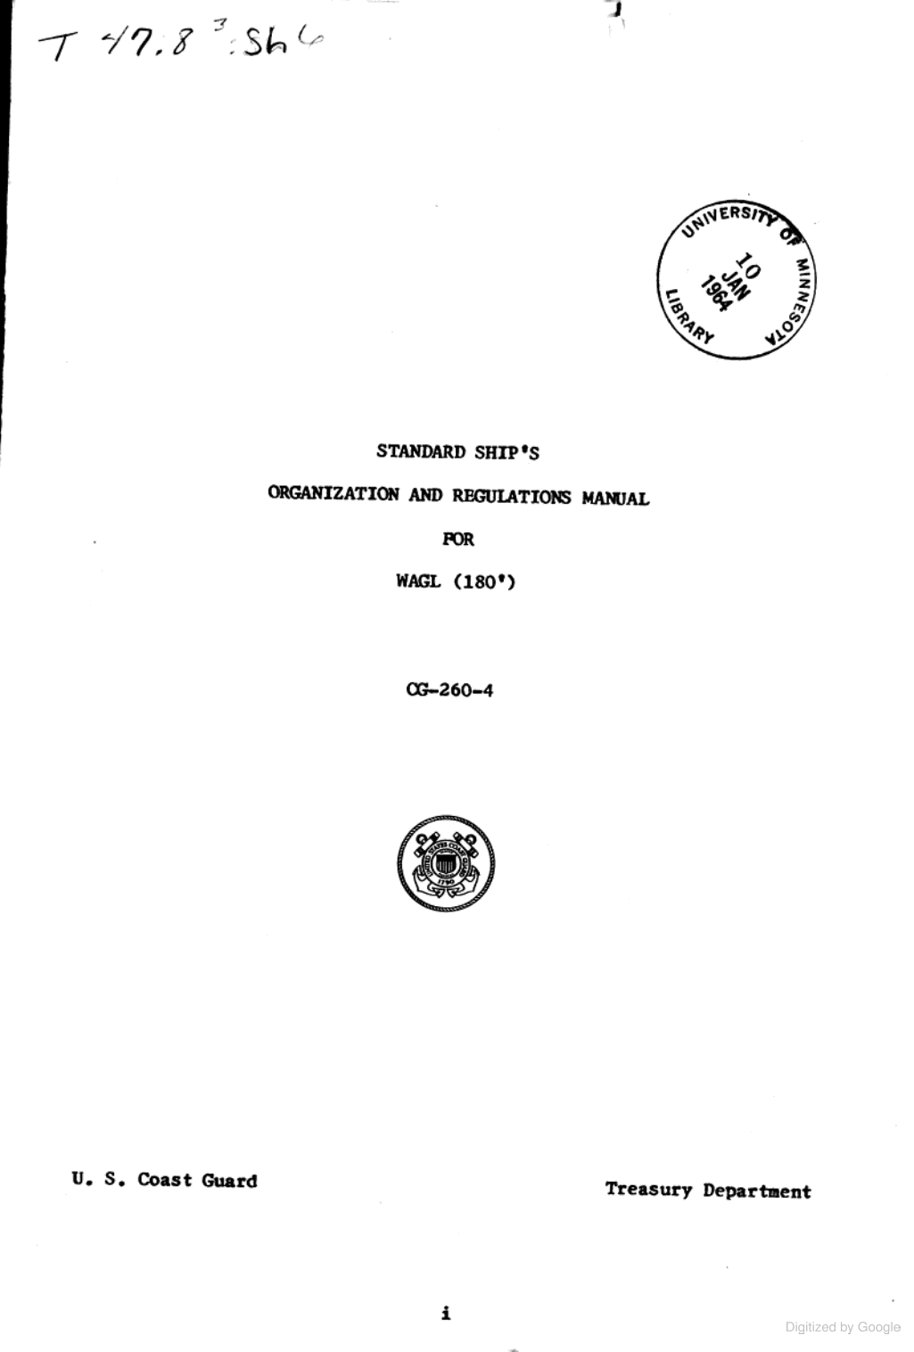
SORM Contents
Purpose Statement
Port of Destination (Team Mission)
Standing Orders (Rules and Team Norms)
Values - Behaviors
Organization of Leadership
Roles and Responsibilities
Battle Rhythm (Team Communication)
Operating Procedures
Decision Making
Plan of the Week (Time Management Ethics)
Sanctions
Conflict Resolution
Waypoints (Objectives)
Vision - Goals - Success
The Cut of One’s Jib
https://books.google.com/books?id=SSOWmzphs5IC&pg=PR5&dq=ship%27s+organization+and+regulations+manual&hl=en&newbks=1&newbks_redir=0&sa=X&ved=2ahUKEwja0uvl34v_AhWbfDABHS6FC3QQ6AF6BAgHEAI#v=onepage&q=ship's%20organization%20and%20regulations%20manual&f=false
Ship’s Organization and Regulations Manual
Slide Contributions: Brandy, Cameron, Sophia and Elyssa

Slide 5
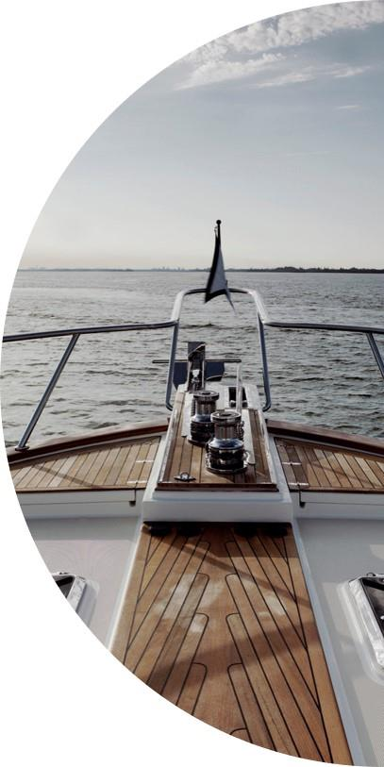

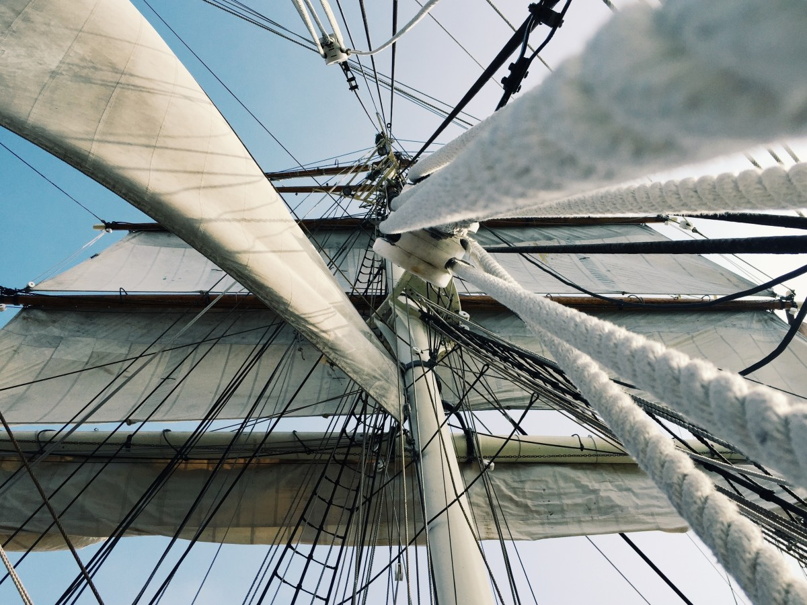
Purpose Statement
To come together as a team to complete missions in a manner that reflects understanding of content material, the importance of team dynamics, and exceed expectations until we go ashore.
F
Slide Contributions: Brandy, Cameron, Sophia and Elyssa

Slide 6

Port of Destination
Demonstrate our ability to effectively collaborate as a crew by producing work that exceeds expectations from understanding content material leading to the successful completion of assigned missions until we go ashore.
F
https://www.istockphoto.com/photo/mission-compass-concept-gm1368778878-438679628
Slide Contributions: Brandy, Cameron, Sophia and Elyssa

Slide 7
Vision
Goals
Success
We will complete missions efficiently while demonstrating an understanding of content material, with respect to team dynamics, and exceed expectations
Effectively collaborate
Exceed expectations
Understand content material
Successful completion of all missions
Demonstrated by our ability to effectively collaborate as a team by producing quality work that exceeds expectations and timely completion of missions
F
Slide Contributions: Brandy, Cameron, Sophia and Elyssa

Slide 8

Waypoints
COMMUNICATE
ENGAGE
RESPECT
OBJECTIVES
DILIGENCE
PORT
PARTICIPATE
of DESTINATION
F
https://elogii.com/blog/route-planning-google-maps/
Slide Contributions: Brandy, Cameron, Sophia and Elyssa

Slide 9
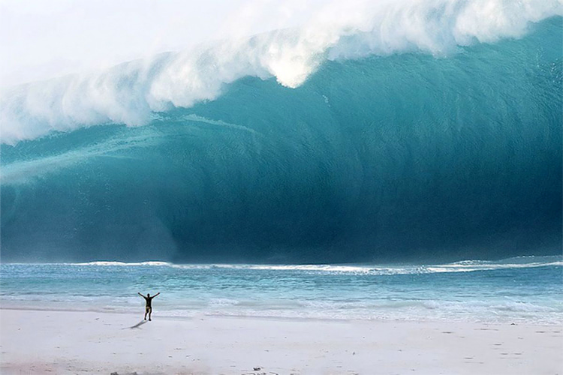


Standing Orders
F
Run A Tight Ship For Plain Sailing
Rocking The Boat In Deep Water
Inactivity
Laziness
Poor Work
Procrastination
Social Loafing
Competition
Distrust
Micromanaging
Groupthink
Gun-Decking
Loose Cannon
Making Waves
Every mate is a captain.
Disrespectful behavior will not be tolerated.
Mission Captain addresses inappropriate behaviors.
Participation will be documented accordingly.
https://www.surfertoday.com/surfing/what-is-a-tsunami
All Crew Members Will:
All Hands On Deck
Show Respect
Participate
Be Diligent
Be Honest
Reliable
Communicate
Show Integrity
Create
Compromise
Collaborate
Negotiate
Innovate
Meetings end with review of questions and concerns.
Group text is an alternative for crew members.
Crew will express concerns, share thoughts and provide feedback.
N
Slide Contributions: Brandy, Cameron, Sophia and Elyssa
https://www.gettyimages.com/detail/photo/sea-and-wave-at-sunrise-royalty-free-image/1169086412?phrase=smooth+water+surface&adppopup=true

Slide 10
VALUES
BEHAVIORS
F
Integrity
Doing the right thing even when no one is looking.
Respect
Treat each mate as you treat Captain.
Diligence
Detail oriented. Hard working. Purposeful.
Honesty
Refusal to lie, cheat or steal.
Effective Communication
Exchanging ideas, thoughts, opinions, knowledge, and data so the message is received and understood with clarity and purpose.
Participation
Be a team player, ready and able to support the crew.
Dependability
Doing what we say we are going to do, when we say we are going to do it.
Cooperation
Work jointly toward the same end.
Compromise
Being flexible and able to meet in the middle to resolve conflict.
Achieving maximum Productivity with minimum wasted effort or expense.
Efficiency
https://languages.oup.com/google-dictionary-en/
Slide Contributions: Brandy, Cameron, Sophia and Elyssa

Slide 11
Organization of Leadership
Mission I
Mission II
Mission III
Mission IV
Captain: Sophia
Recorder: Brandy
Timekeeper: Elyssa
Crew: Cameron
Captain: Brandy
Recorder: Sophia
Timekeeper: Cameron
Crew: Elyssa
Captain: Elyssa
Recorder: Cameron
Timekeeper: Sophia
Crew: Brandy
Captain: Cameron
Recorder: Elyssa
Timekeeper: Brandy
Crew: Sophia
F
Roles have been assigned as outlined. Meeting agendas are to be completed by the team Captain for respective mission. Team Captain will submit completed assignment prior to deadline with group approval.
Slide Contributions: Brandy, Cameron, Sophia and Elyssa

Slide 12
The Cut of One’s Jib
Sophia - ESFJ
Observant
Brandy - ISTJ
Elyssa – INFJ
Cameron - INFJ
People-oriented
Organized
Loyal
Detail-oriented
Reserved
Dependable
Perseverant
Altruistic
Creative
Determined
Passionate
Practical
Communicative
Empathetic
Vision
S
Worrier
Judgmental
Lack of creativity
Rigid
Inflexible
Resistant to change
Private
Sensitive
Conflict averse
Impatient
Closed-off
Perfectionist
Potential Conflicts
Our team does not have many potential conflicts; however, 3 of the 4 Mateys are introverts. This has not been an issue thus far, as all Mateys are participating in meetings and communicating. Our group personality types cover the entire spectrum (except for Perceiving), which allows us to bridge any weaknesses within the group dynamic.
Slide Contributions: Brandy, Cameron, Sophia and Elyssa

Slide 13
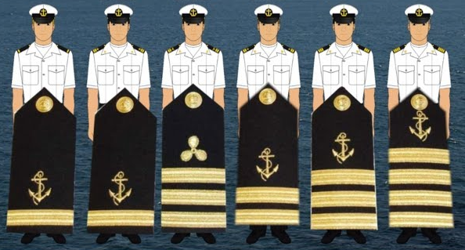
Roles and Responsibilities
As a team, our key responsibilities are to participate, engage, complete assigned tasks to the best of our abilities and communicate with a positive attitude.
Crew members are counting on us to participate, communicate, and complete assigned tasks.
It is every team member's responsibility to communicate ideas, questions, feedback, conflicts, and to request help when needed.
F
https://i.ytimg.com/vi/1myfbEmqa5o/maxresdefault.jpg
Slide Contributions: Brandy, Cameron, Sophia and Elyssa

Slide 14
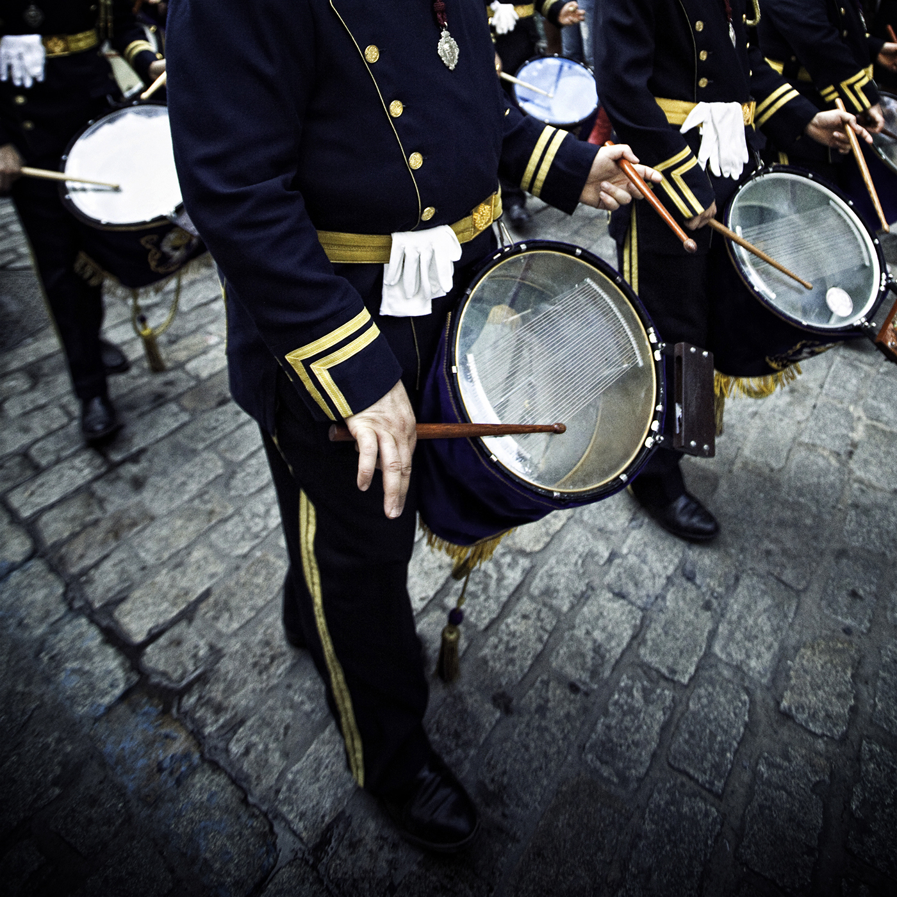
Mission Communications
N
Run a tight ship for plain sailing
Captain is responsible for compiling and communicating information to the crew via agenda, text, or email.
Group text serves as the primary method of crew communication.
Responses expected within 8 hours.
Crew participation is expected.
Team will proceed with majority vote (3/4)
Captain to communicate time-frame and resources needed to ensure prompt completion of tasks.
Logbook will be shared with crew members to allow simultaneous work.
Individual assignments to be completed by or before agreed upon deadlines.
Captain to submit mission logbook prior to deadline and notify crew of completion.
F
Battle Rhythm
Stock Photo
Slide Contributions: Brandy, Cameron, Sophia and Elyssa

Slide 15

Operating Procedures
F
Team Meetings
Meetings are on Sundays with check ins as needed.
Meetings are held through Microsoft Teams and primary method of communication is group text.
Agendas
Mission Captain- Responsible for scheduling and facilitating meeting(s), preparing agenda(s), ensuring individual tasks are complete, and submission of logbook.
Meeting duration determined by workload of mission.
Recorders- Responsible for documenting discussions, decisions and assignment of tasks, and sharing minutes with crew for review and approval.
Time-Keeper- Responsible for tracking time spent discussing agenda items to ensure meetings are efficient.
S
Slide Contributions: Brandy, Cameron, Sophia and Elyssa

Slide 16
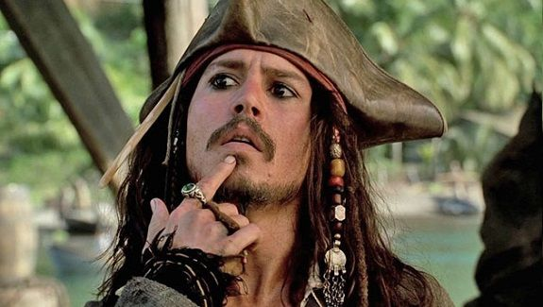
Decision Making
https://www.pinterest.com/pin/151011393733201406/
Most of our decisions made are upon majority vote...if there is any miscommunications that is when our captain of the week will review further instructions to provide the clarification needed to the crew.
Crew members independently decide how to complete selected mission tasks.
Each week the captain will facilitate task assignments – allowing crew members to select individual tasks.
Agreement from each crew member that the assignment is top tier is required before anything is to be submitted.
N
Slide Contributions: Brandy, Cameron, Sophia and Elyssa

Slide 17



Plan of the Week - Time Management
Attendance
Preparation and Deadlines
Every effort must be made to communicate absences or scheduling conflicts.
Tasks are completed through shared documents to allow real time access for crew to work collectively.
Captain's absence is detrimental. If Captain is unable to submit mission documents, a delegated matey will adjust mission’s documented participation percentage and submit.
Crew is expected to be prepared for meetings and complete tasks as assigned. Being unprepared reflects poor teamwork whether it is detrimental or not to the mission. It is the Captain's responsibility to reschedule meetings when necessary.
Missing deadlines is unacceptable. Each matey is responsible for communicating needs, conflicts, and/or delays for timely completion of tasks. Lack of communication or missing deadlines will result in documentation of poor participation that could lead to removal.
Stock Photo
Timeliness
Early departures and late arrivals are inevitable; however, communication is expected as a courtesy.
Past due, late or incomplete tasks are detrimental to the crew and overall mission. A delegated mate or volunteer will pick up the slack to ensure a successful mission and poor participation will be documented.
N
F
Stock Photo
https://www.flaticon.com/free-icon/absent_4861013
Slide Contributions: Brandy, Cameron, Sophia and Elyssa

Slide 18



Sanctions
S
Means for Crew Member Sanction
Fails to carry their weight
Breaks group rule.
Lack of participation
Left high and dry – abandoned.
First Offense
Captain to address inappropriate behavior with crew member(s).
Points deducted from assignment.
Second Offense
Captain requests crew member be removed.
Points deducted from assignment = a failed mission for the crew member.
A shot across the bows - warning shot.
Slide Contributions: Brandy, Cameron, Sophia and Elyssa
https://www.creativefabrica.com/product/walk-the-plank/
https://tshirt-factory.com/man-overboard.html

Slide 19



Conflict Resolution
DECIDE MODEL
D – Define Problem​
E – Establish criteria​
C – Collect and analyze data​
I – Identify possible solutions​
D – Defend & implement option​
E – Evaluate solution
N
https://images.squarespace-cdn.com/content/v1/5da9d4fa7e42095872ed7c43/1617753821753-0ATDKEE0B09RTC18DSLW/maxresdefault.jpg?format=500w
Resolving Disagreements
Stem and tide – try to prevent a situation from becoming worse than it is.
The Voyagers will resolve disagreements by discussions and majority vote. If a split or tie leaves the team dead in the water, the Captain will review mission instructions for clarification.
Trim One’s Sails
Adapt or change to fit altered circumstances when the results of not following through do not impact the outcome. When the outcome is detrimental, document event that led to going off course.
S
https://www.ebay.com/itm/385284778557
https://www.gard.no/web/updates/content/23769855/conflict-and-compromise-maritime-dispute-resolution
DECIDE model, discussions, review of mission details, parley, and if necessary, clarification from professor or TA.
Slide Contributions: Brandy, Cameron, Sophia and Elyssa

Slide 20

Port of Destination
We have concluded the SORM review. Throughout this journey, we summarized our planned intended movement (PIM) by reviewing the ship’s organization and regulation manual (SORM). We outlined our purpose statement, port of destination, vision-goals-success, waypoints, standing orders, values and behavior, Organization of Leadership, The Cut of One's Jib, Roles and Responsibilities, Battle Rhythm, Operating procedures, decision making plan, plan of the week - time management, sanctions and conflict resolution. We hope you found this information beneficial as you continue to learn the ropes.
Thank you for helping us locate the missing pieces of the manifest! The crew is aboard and we are about to get underway. Will you join us for Mission III?
“May you have fair winds and following seas until next time.”
Slide Contributions: Brandy, Cameron, Sophia and Elyssa
https://wallpaperboat.com/anchor-iphone-wallpapers

Slide 21






Brandy Lee
Captain
100%
Cameron Leyva
Timekeeper
100%
Sophia Veilleux
Recorder
100%
Elyssa Lewis
Crew
100%
https://lhsagm.ejoinme.org/AllHandsOnDeck
Slide Contributions: Brandy, Cameron, Sophia and Elyssa

Slide 22
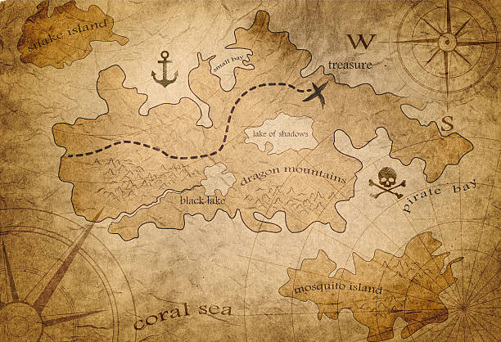
The Voyagers’ Virtual Tuckman Team Development Process
Forming
Storming
Norming
  Purpose Statement
  Port of Destination
  Vision-Goals-Success
  Waypoints
  Standing Orders
  Values and Behavior
  Organization of Leadership
  Roles and Responsibilities
  Battle Rhythm
  Operating Procedures
  Plan of Week – Time Management
  The Cut of One's Jib
  Operating Procedures
  Sanctions
  Conflict Resolutions
  Standing Orders
  Battle Rhythm
  Decision Making
  Plan of the Week – Time Management
  Conflict Resolution
Slide Contributions: Brandy
https://www.istockphoto.com/photo/pirate-treasure-map-gm611868178-105311251
Scavenger Hunt Answer Key

